Slide 1

 | S.S.V.P.S’s B. S. Deore Polytechnic, Dhule Department of Computer Engineering Academic Year : 2026-2027
SEMINAR AND PROJECT INITIATION COURSE
Sem : CO 5 K |  | SPI – 315003 | Date : 17/10/2026
Topic : Brain Computer Interface
Roll No. |  | Name of Student
96 |  | Sonawane Neeraj Anil
91 |  | Rajput Ranveer Raosaheb
80 |  | Shivade Sai Devidas
126 |  | More Nayan Jagdish

Slide 2
Contents
Certificate
Abstract
Introduction
Literature Review
Information to Seminar topic
Advantages and Disadvantages
Conclusion
Project Initiation :
6. 1 Description of Problem Statement.
6. 2 Scope and Objectives.
6. 3 Stake holder
6. 4 Seminar Discussion Plan
6.5 Platform/ Equipment/ Resources identification.
Bibliography
References

Slide 3
Abstract
Brain–Computer Interface (BCI) is an advanced technology that enables direct communication between the human brain and a computer or external device. It records brain signals, processes them, and converts them into commands to control different devices without using traditional input methods.
BCI technology has various applications in healthcare, assistive communication, robotics, and human–computer interaction. It can help people with physical disabilities interact with computers and other devices more easily.
Although BCI offers many benefits, it faces challenges such as signal noise, accuracy, high cost, and data privacy. With further advancements in technology, BCI has the potential to improve the way humans interact with machines.

Slide 4
1. Introduction
In today's world, technology is continuously changing the way humans interact with computers and electronic devices. However, people with severe physical disabilities may face difficulties using traditional input devices such as keyboards and mice. We chose the Brain–Computer Interface (BCI) topic because it provides a new way to communicate with computers using brain signals.
The proposed BCI system aims to interpret brain signals and convert them into commands through the following stages:
Signal Acquisition: Records brain activity using suitable sensors such as EEG electrodes.
Signal Processing: Removes noise and prepares the recorded signals for analysis.
Feature Extraction: Identifies important patterns from the processed brain signals.
Classification: Recognizes signal patterns and maps them to predefined commands.
Device Control: Uses the recognized commands to control a computer or another compatible device.
This technology may support assistive communication, healthcare research, and human–computer interaction. However, its performance depends on signal quality, classification accuracy, and the equipment used.

Slide 5
2. Literature Survey
Sr. No. | Research Topic | Description
1 | BCI Advancements and Challenges | Studies BCI working principles, signal processing, accuracy, and limitations.
2 | BrainGate | Explores brain-controlled communication and device control for people with paralysis.
3 | Neuralink | Studies implantable neural interfaces for communication between the brain and computers.
4 | EEG-Based BCI | Explains how EEG signals can be used to control computers and assistive devices.
5 | Machine Learning in BCI | Uses machine learning to classify brain signals and improve command recognition.
6 | BCI in Neurorehabilitation | Explores BCI applications in rehabilitation for people with motor disabilities.

Slide 6
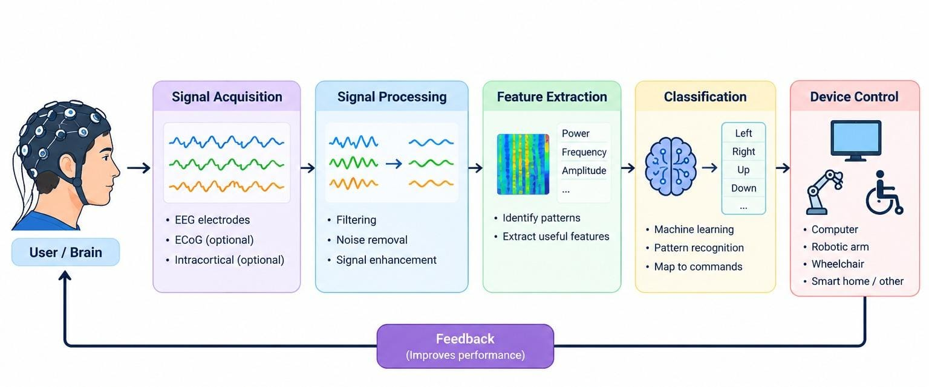
2.1 Literature Review: Method Families
Fig. 2.1: Method Families in the Reviewed Research Papers
Research Gap:Existing Brain-Computer Interface (BCI) systems face several challenges, including noisy EEG signals, limited classification accuracy, and variations in brain activity among users. Signal preprocessing, feature extraction, and machine learning techniques are required to improve system performance. Other limitations include calibration requirements, high equipment costs, and difficulties in achieving reliable real-time control. Therefore, further work is needed to develop affordable, accurate, and user-friendly BCI systems. This project focuses on exploring EEG signal processing and machine learning-based classification for a simple, non-invasive BCI prototype.

Slide 7
3. Information to Seminar topic
The proposed Brain-Computer Interface (BCI) system follows four main stages: Signal Acquisition → Signal Processing → Machine Learning → Device Control. Each stage performs a specific task to convert brain activity into commands for an external device.
1. Signal Acquisition: The system acquires brain signals using EEG electrodes placed on the scalp. If live EEG hardware is unavailable, prerecorded EEG datasets may be used for demonstration purposes.
2. Signal Processing: The acquired signals are filtered to reduce noise and unwanted artifacts. Feature extraction identifies useful patterns and characteristics from the processed signals, preparing them for classification.
3. Machine Learning (ML): The machine learning stage analyzes extracted features and classifies brain-signal patterns into predefined categories. The recognized classes are mapped to commands based on the available training data and evaluation results.
4. Device Control: The classified commands are displayed through a simple graphical interface, such as selecting symbols or moving a simulated cursor. The proposed prototype is intended for educational demonstration and will not control safety-critical devices or be used for medical diagnosis or treatment.

Slide 8
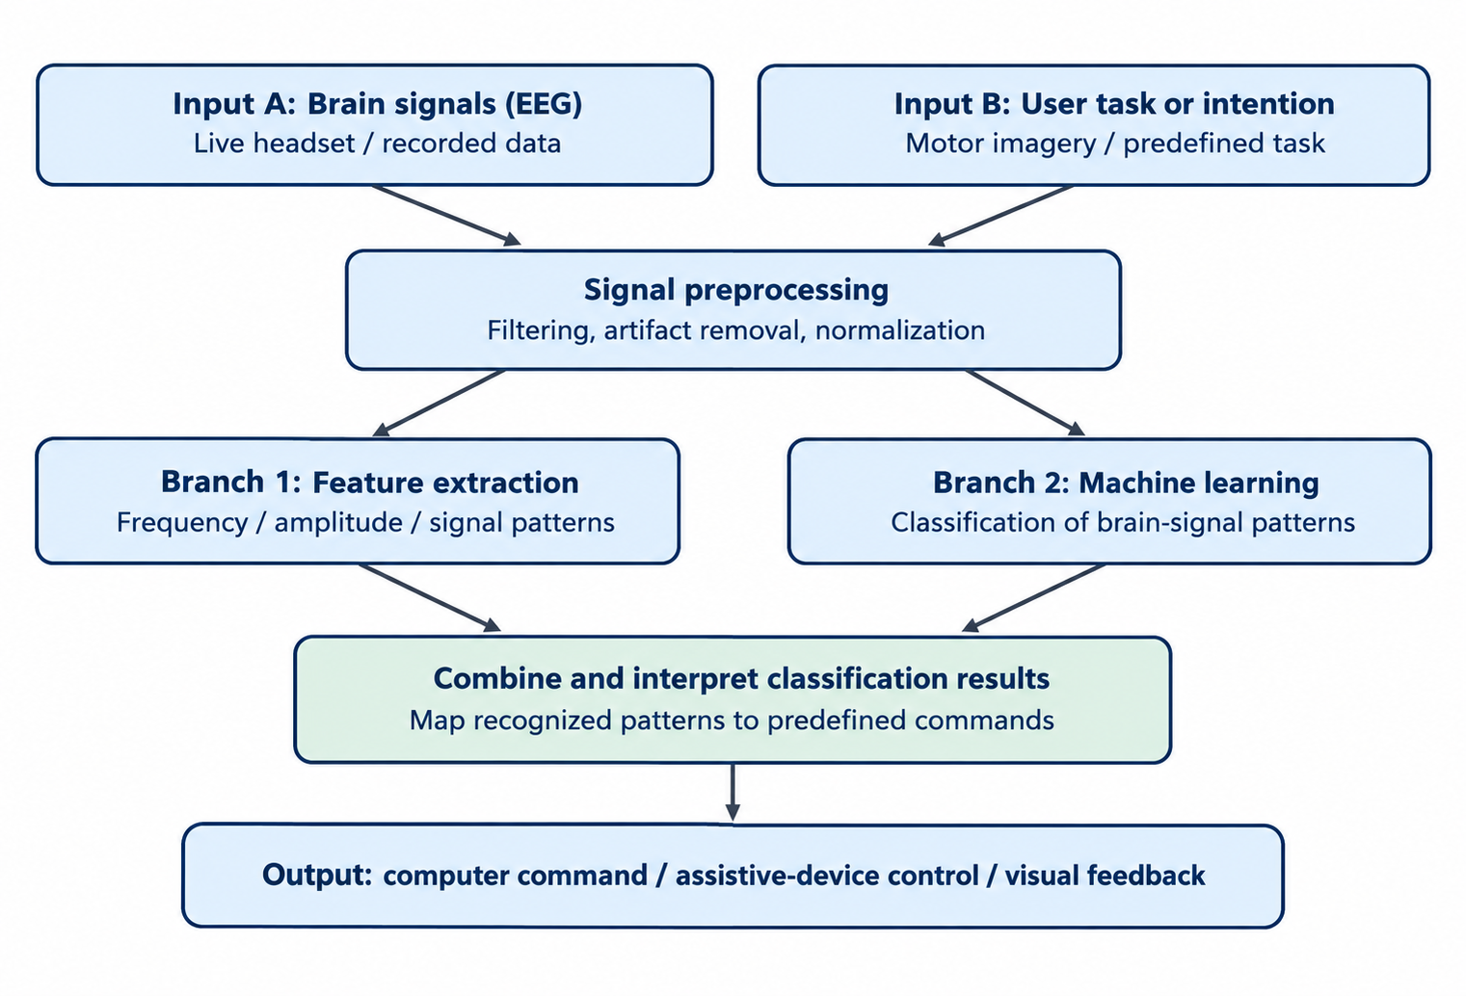
3.1 Proposed System Architecture
Fig. 3.1: BCI system architecture diagram

Slide 9
4. Advantages / Disadvantages
Advantages
Direct Communication: Enables communication between the brain and external devices.
Assistive Technology: Helps people with physical disabilities interact with computers and other devices.
Rehabilitation Support: Supports research into rehabilitation for patients with motor impairments.
Hands-Free Control: Allows device control without relying entirely on physical movements.
Wide Applications: Can be used in healthcare research, robotics, gaming, and human-computer interaction.
Disadvantages
High Cost: Advanced BCI equipment can be expensive.
Signal Noise: Brain signals can be weak and affected by noise and artifacts.
Limited Accuracy: Classification errors can lead to incorrect commands.
Training Requirements: Users may need calibration, practice, and repeated sessions.
Privacy and Safety Concerns: Brain-signal data requires careful protection, and invasive systems involve surgical risks.

Slide 10
5. Conclusion
Brain-Computer Interface (BCI) is an emerging technology that enables direct communication between the human brain and external devices. It works by acquiring brain signals, processing them, extracting useful features, and converting them into commands using classification techniques. BCI technology has promising applications in assistive communication, rehabilitation research, robotics, and human-computer interaction. However, challenges such as signal noise, limited accuracy, high cost, and privacy concerns remain. With advancements in signal processing, machine learning, and sensor technology, BCI systems have the potential to become more reliable, accessible, and user-friendly in the future.

Slide 11
6. Project Initiation
Project initiation defines the main problem, objectives, scope, stakeholders, and resources required for the proposed system.
The proposed project aims to develop an educational Brain-Computer Interface (BCI) system that acquires and analyzes brain signals, identifies signal patterns, and converts them into commands for computer interaction. It focuses on EEG signal processing, machine learning-based classification, and displaying recognized commands through a simple graphical interface.
The project planning phase helps identify the necessary technologies, software tools, equipment, and resources required for implementation and testing.

Slide 12
6. 1 Description of Problem Statement
Problem
BCI systems may struggle to acquire clear and reliable brain signals.
Noise and unwanted artifacts can affect signal quality.
Accurate classification of brain-signal patterns remains challenging.
Differences in brain activity between users can affect system performance.
Real-time control may require calibration, training, and suitable equipment
Problem Statement
To design a system that acquires and processes brain signals to identify patterns and convert them into computer commands. The system aims to improve signal classification and enable basic computer interaction. It provides a simple, non-invasive BCI demonstration for educational purposes.

Slide 13
6. 2 Scope and Objectives
Scope:
Study the basic principles and working of Brain-Computer Interface (BCI).
Explore non-invasive EEG signal acquisition and preprocessing.
Apply feature extraction and machine learning techniques to classify brain-signal patterns.
Display recognized commands through a computer interface.
Objectives:
Understand the major stages of a BCI system.
Reduce noise and improve EEG signal quality.
Classify brain-signal patterns into predefined commands.
Demonstrate basic computer interaction using a simple BCI prototype.
Evaluate the system’s performance and identify its limitations.

Slide 14
6. 3 Stake holder
The main stakeholders proposed of
Brain Computer interface are:
Stakeholders
End Users: People with motor disabilities who may benefit from BCI-based interaction.
Developers: Students responsible for designing and implementing the BCI system.
Healthcare Professionals: Doctors, therapists, and rehabilitation specialists who may use BCI technology.
Hardware and Software Providers: Providers of EEG equipment, software tools, and related technologies.
System Administrators: Responsible for maintaining the computer system and software environment.
Project Guide and Evaluators: Provide guidance, monitor progress, and evaluate the project.
Institute and Department: Support the project through academic resources and facilities.

Slide 15
6. 4 Seminar Discussion Plan
The seminar discussion will cover the following topics:
Introduction to Brain-Computer Interface (BCI).
Literature survey and existing BCI approaches.
Overview of EEG signal acquisition, processing, and machine learning.
Proposed system architecture and working process.
Advantages, disadvantages, and applications.
Project scope, objectives, and required resources.
Conclusion and future improvements.

Slide 16
6.5 Platform/ Equipment/ Resources
Hardware Requirements
Computer or laptop.
Minimum 4 GB RAM; 8 GB recommended.
EEG headset (optional).
Software Requirements
Operating System: Windows or Linux.
Programming Language: Python.
Development Environment: VS Code or Jupyter Notebook.
Libraries: NumPy, MNE-Python, and scikit-learn.
Other Resources
Live EEG signals or prerecorded datasets.
Sample brain-signal data for testing.
Computer interface to display recognized commands.

Slide 17
Bibliography
Books
Brain-Computer Interfaces: Principles and Practice — Wolpaw and Wolpaw (2012).
Research Papers
Brain-Computer Interfaces for Communication and Control (2002).
Brain Computer Interfaces, a Review (2012).
Brain Computer Interface: Control Signals Review (2017).
Websites
OpenBCI Documentation — https://docs.openbci.com/
MNE-Python Documentation — https://mne.tools/stable/
Python Documentation — https://docs.python.org/3/
Scikit-learn Documentation — https://scikit-learn.org/stable/user_guide.html
NumPy Documentation — https://numpy.org/doc/
MathWorks EEG Documentation — https://www.mathworks.com/help/eeg/

Slide 18
References
[1] J. R. Wolpaw et al., “Brain–Computer Interfaces for Communication and Control,” Clinical Neurophysiology, 2002.
[2] L. F. Nicolas-Alonso and J. Gomez-Gil, “Brain Computer Interfaces, a Review,” Sensors, 2012.
[3] N. Padfield et al., “EEG-Based Brain-Computer Interfaces Using Motor-Imagery: Techniques and Challenges,” Sensors, 2019.
[4] MNE-Python Documentation: https://mne.tools/stable/
[5] OpenBCI Documentation: https://docs.openbci.com/

Slide 19
Thank you

